Slide 1

WithU
Sam Patterson, Joshua Chaimson, Pritesh Kalantri, Will Roberts, Mingren Shen, Shantanu Singhal, Jason Waner

Slide 2
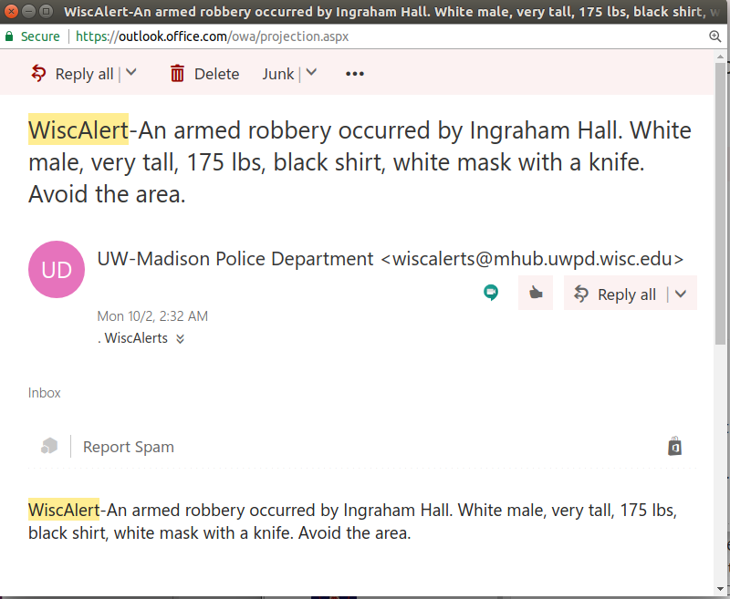
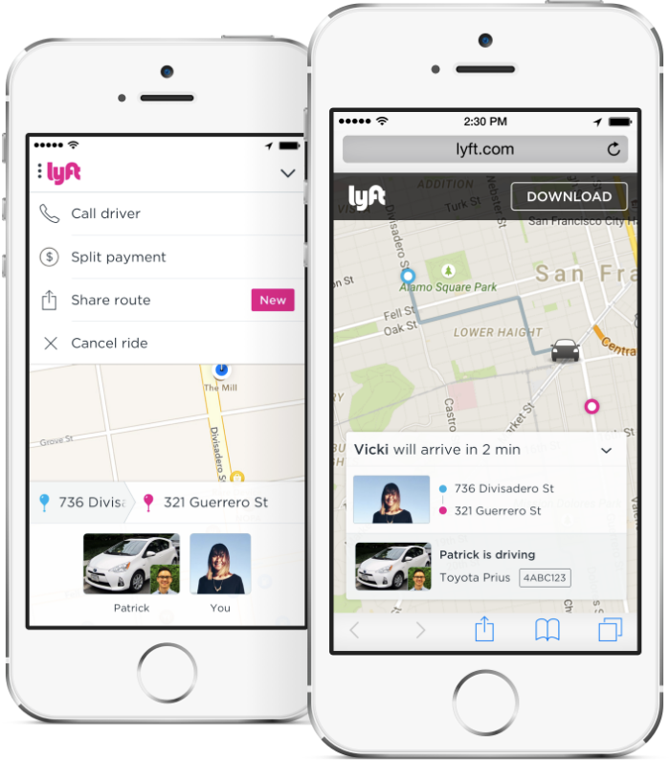
Introduction
What Is It?
Substitute for SAFEwalk
A service for UW students to easily request a walk home
Why Is It Needed?
We believe that SAFEwalk’s current system is out of date, and that is why not enough people use it
Our main goal is to make the process of requesting a walk as quick and simple as possible
Large map interface
Only a few clicks to request a walk

Slide 3



Design: Platform and APIs
Android Studio
Team is familiar with Java
Firebase functionality built into Android Studio
Google Maps API
Gives us the ability to create a large map UI
Functionality to:
Create a path from one point to another
Estimate time to a destination
Convert longitude and latitude into nearest street address
Google Firebase
Has a host of systems which speed up the backend development process
Systems:
Authentication
Real-time Database
Cloud Storage

Slide 4
Iteration Details
Iteration 1
User and Walker Sign Up / Sign In
Walker Pairing
Walk Request
Iteration 2/3
Walk Directions
Account Info/Walk History
Calling the Requestor
Reporting/Rating Walkers
Emergency Calling

Slide 5


